Slide 1
Clarity
The newest minimalist team and project management solution.

Slide 2
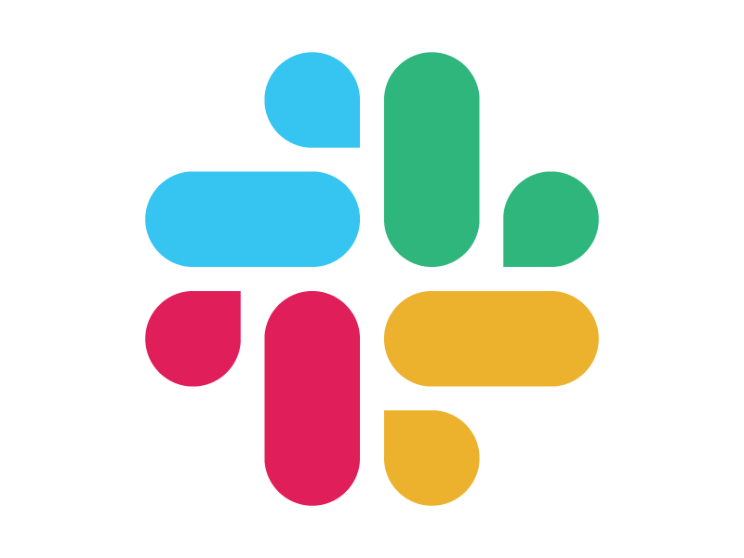

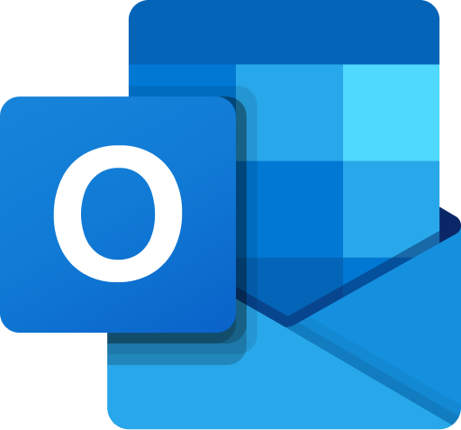

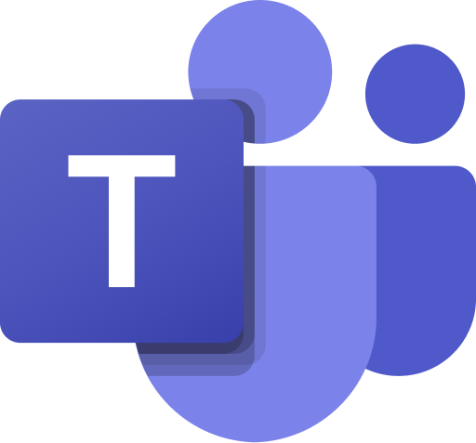
Why does this product exist?
Simplicity is the name of the game. While Git-hub is a juggernaut that is not easily surpassed when it comes to storing and retrieving codebases, many teams face issues with having to juggle multiple communication and development tracking platforms

Slide 3
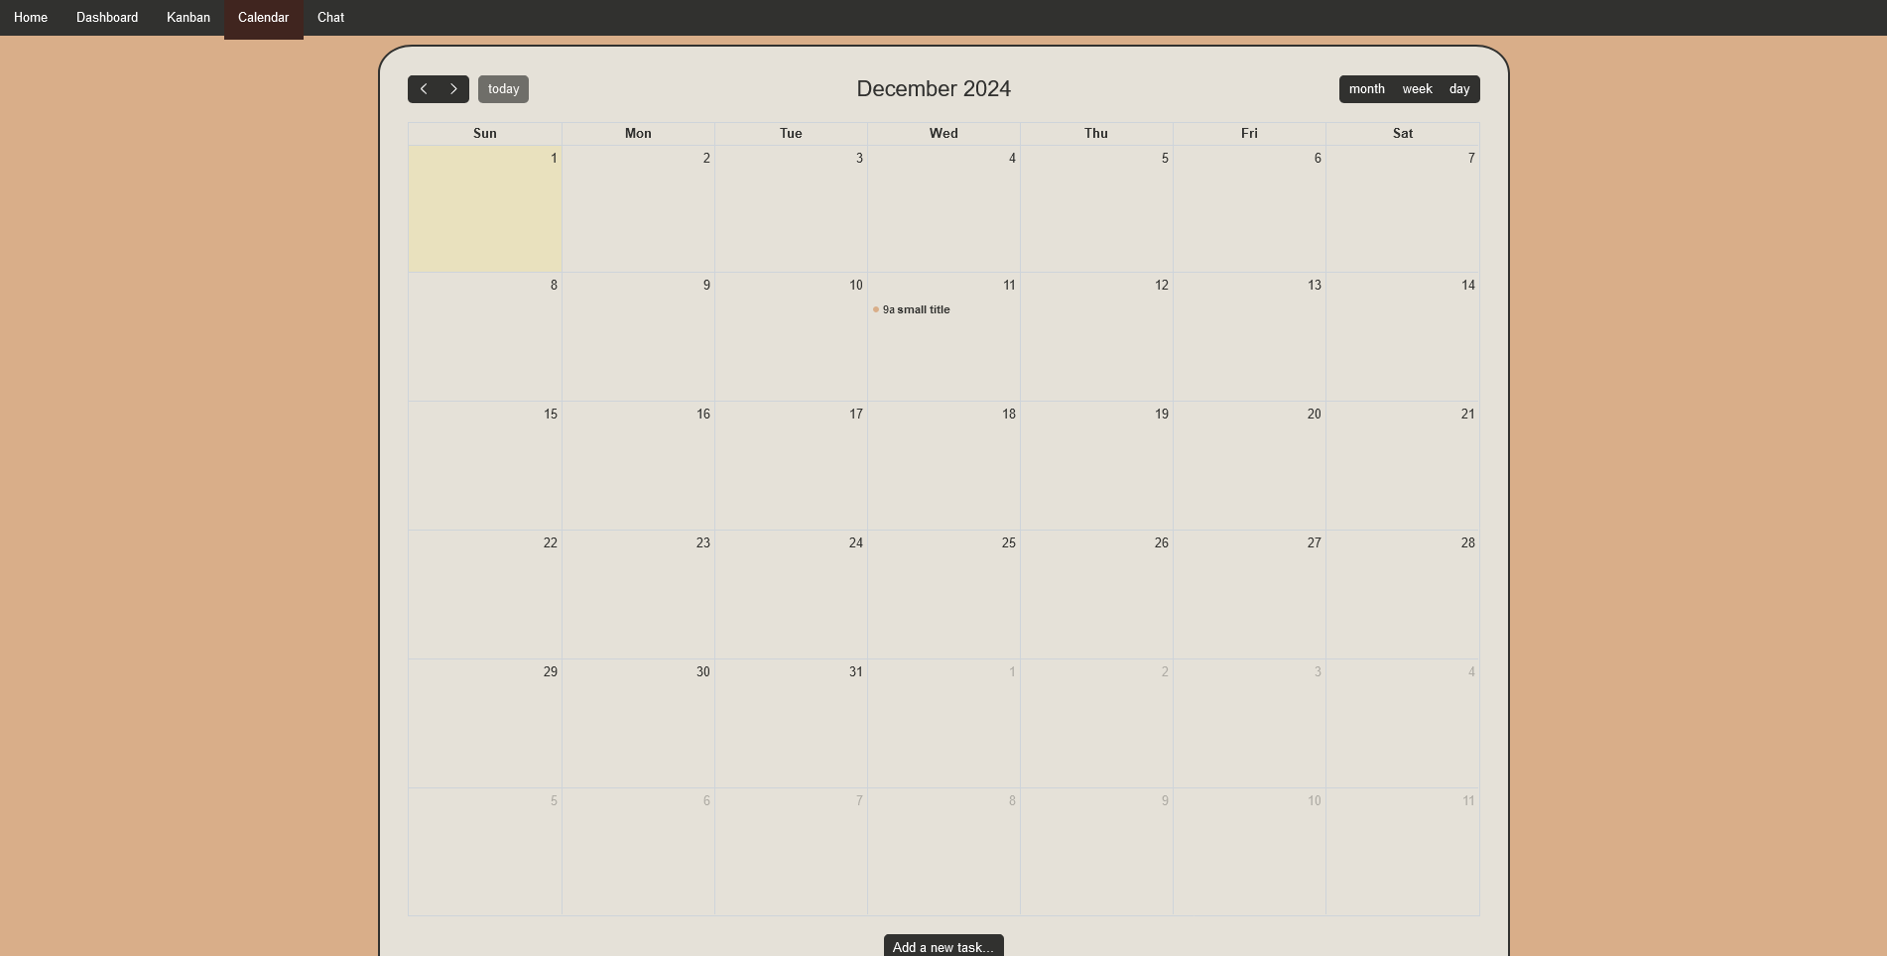
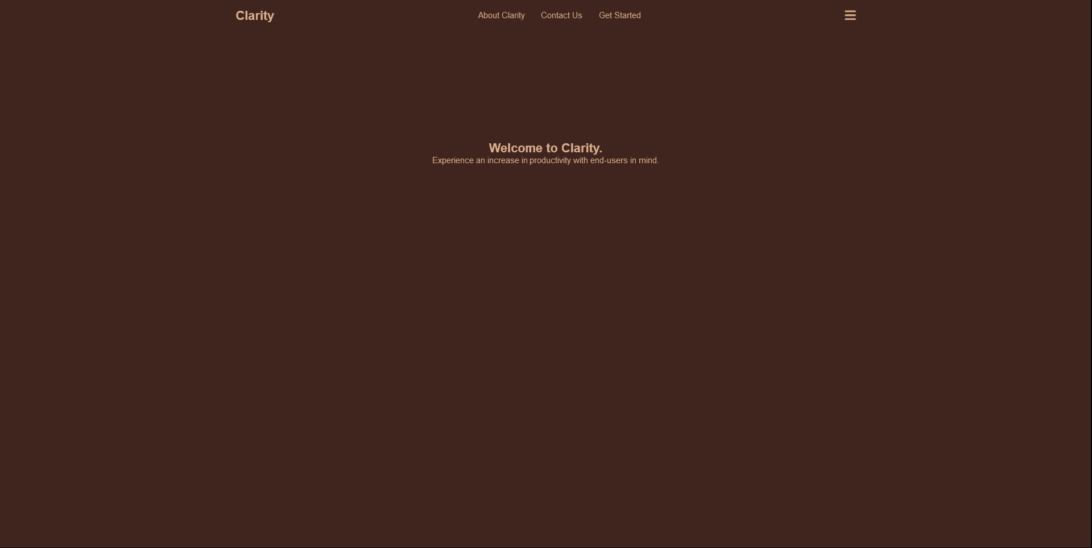
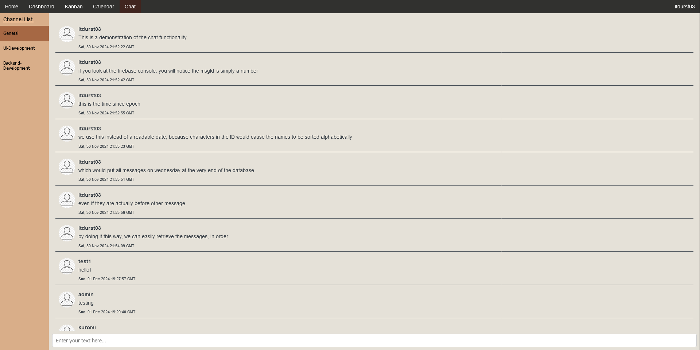
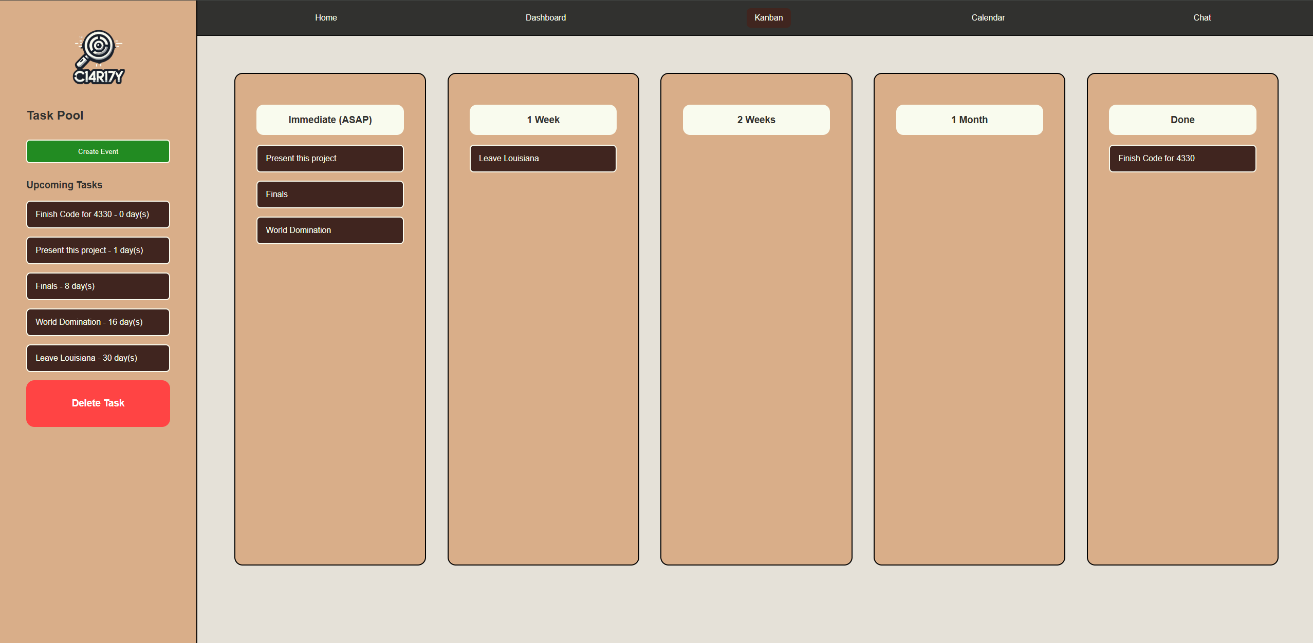
Core Features

Slide 4
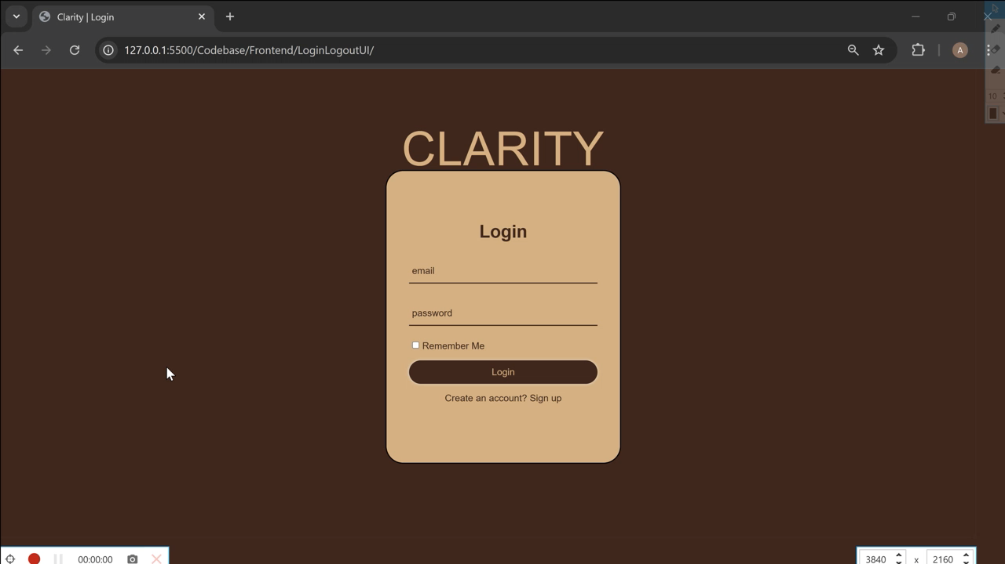
Login / Profile

Slide 5
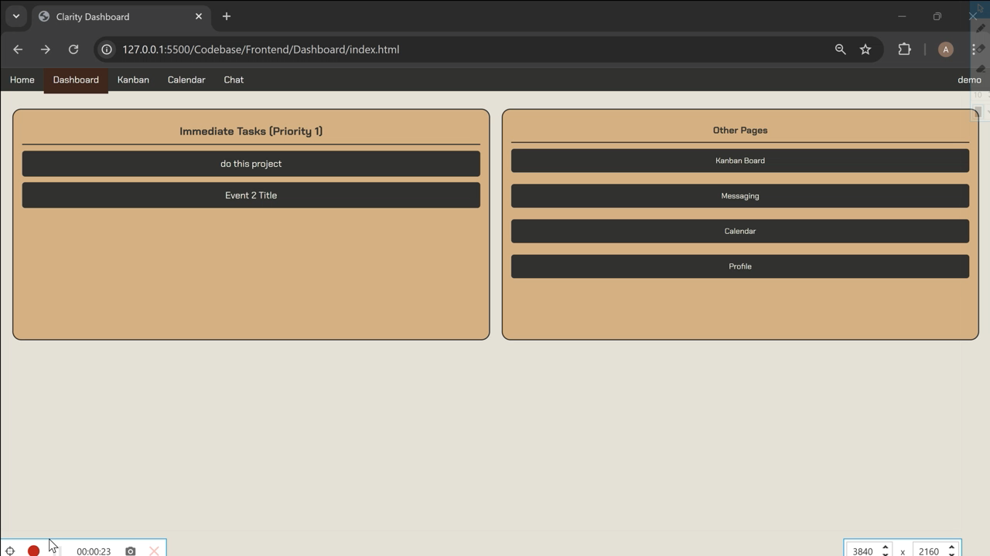
Dashboard

Slide 6

Kanban Board

Slide 7
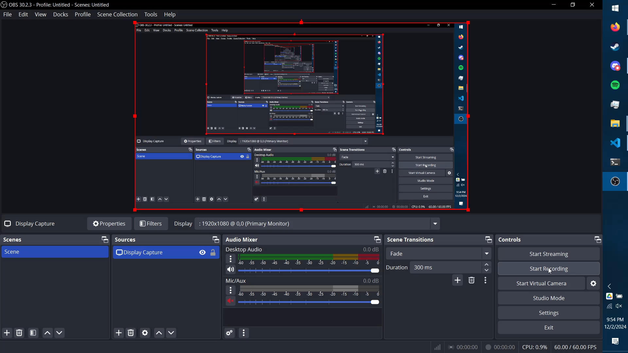
Calendar

Slide 8
The Chatroom

